Slide 1
Deploy your app on Kubernetes in 1 hour!
How pieces of code become a managed deployment in Kubernetes infrastructure
Lubomir Kaplan, 27.3.2025

Slide 2
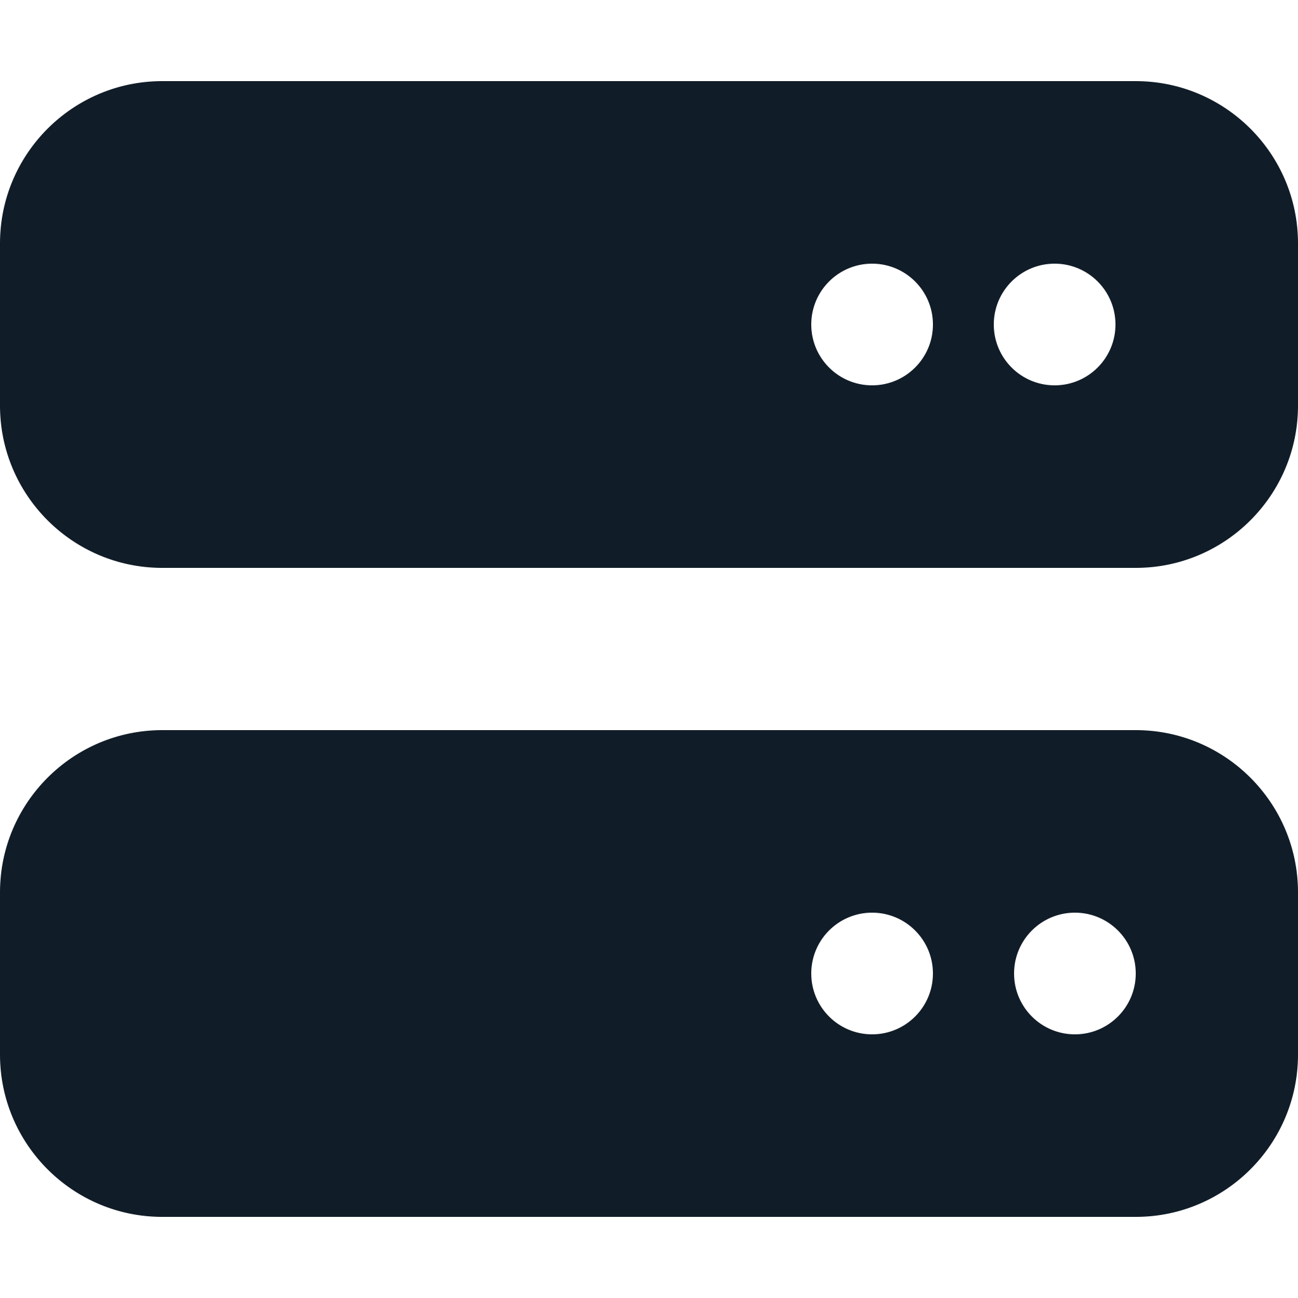

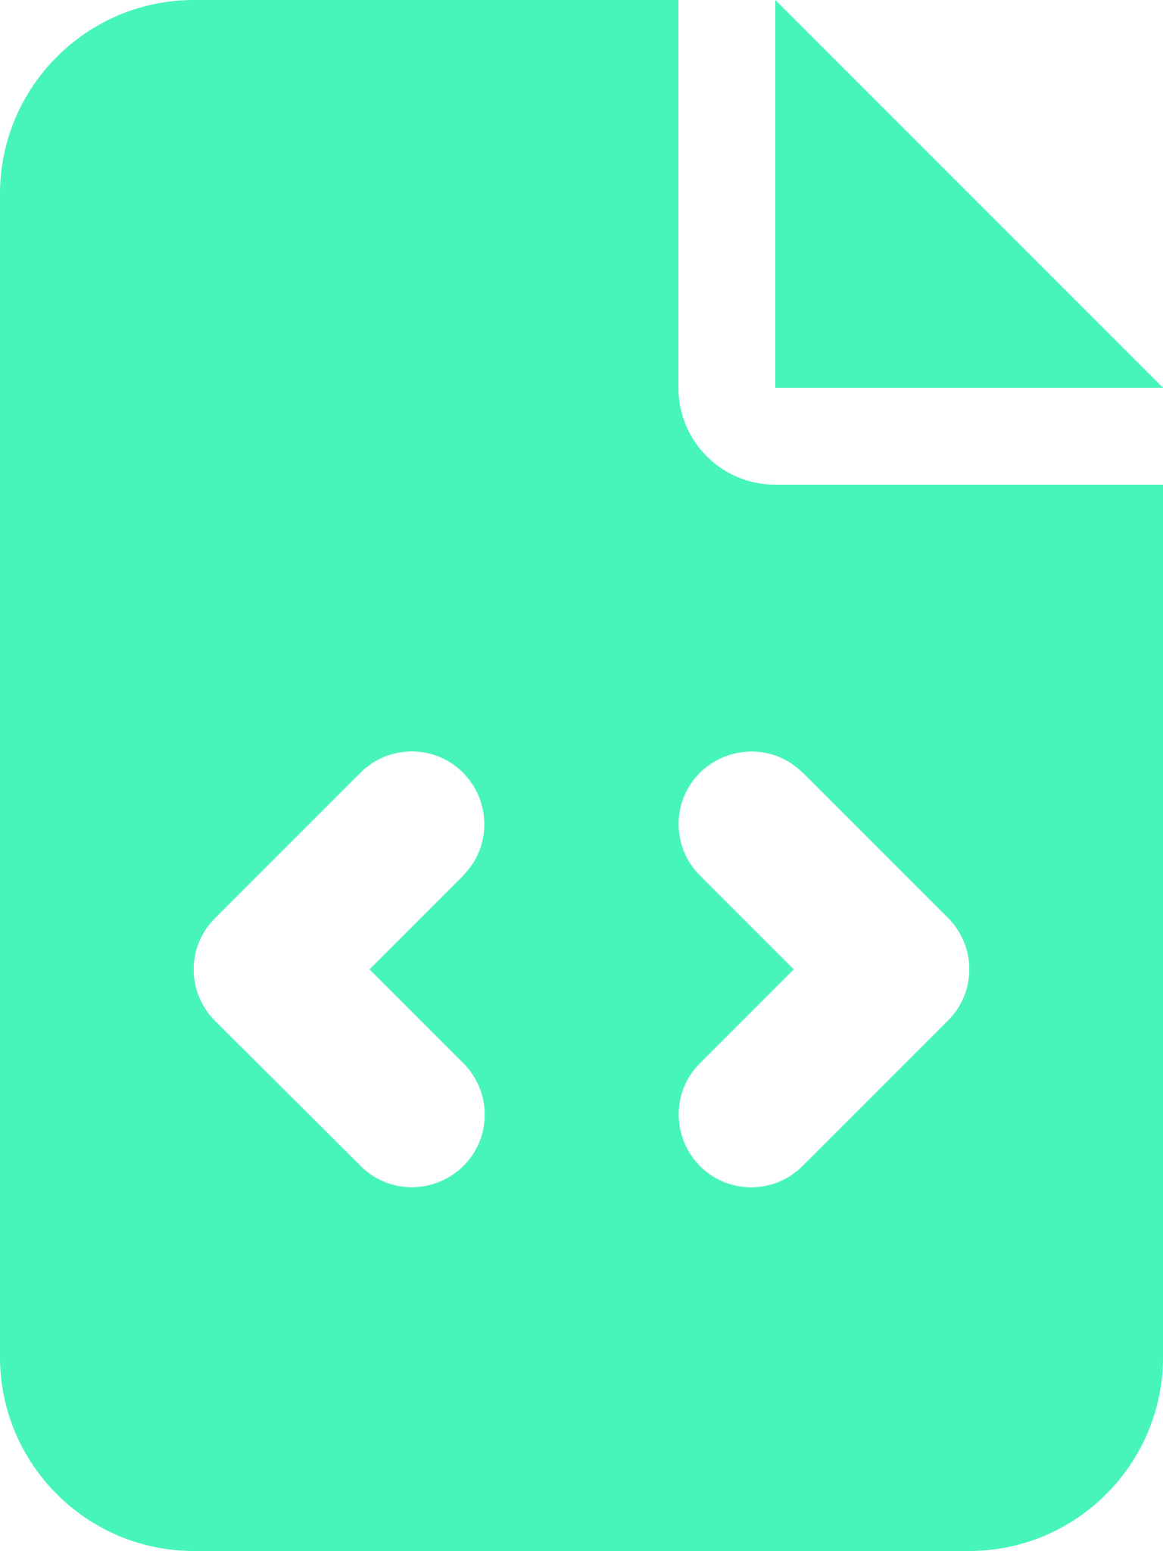


It used to be simple
Server
FTP
SFTP
RSYNC
HTTP
HTTPS
Developer
Code
Target
Audience
Shared
Hosting

Slide 3
It used to be simple
Everything was done manually (or with a few scripts),
Most web applications were (are) developed in PHP
Deployment → Upload of source code
Shared webserver
Shared database
…or deployed on VPS or bare-metal servers as standalone applications
Manual setup and management
Manual updates

Slide 4





Need Environments!
Development
Staging
Production
Application
Database
Application
Database
Application
Database
Developers
Testers / QA
Target Audience

Slide 5
Need Environments!
Isolation for development, staging, production
As many of them as necessary
Prevents production bugs or outages by separation of unstable environments
Complexity of environment management rises!

Slide 6




It doesn’t work ON MY PC!
Your PC
My PC
Ubuntu
18.04 (x86)
PostgreSQL
12
Python
2.9
Mac OS
15.3 (arm64)
PostgreSQL
16
Python
3.12
NodeJS
14
Application
NodeJS
22
Application

Slide 7
It doesn’t work ON MY PC!
Differences CPU architecture (amd64 vs. arm64)
Differences in operating system (kernel)
Differences in system library versions (glibc, …)
Differences in runtime versions (NodeJS, Python, Java, …)
Differences in foundation application versions (databases, caches, …)
Need for environment standardisation. Welcome containers!

Slide 8
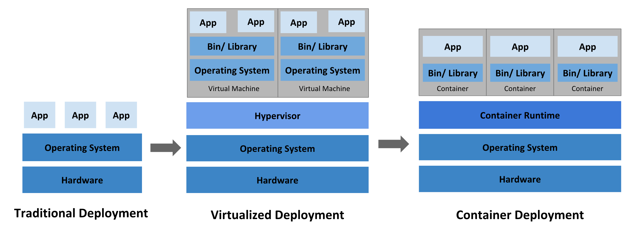
Containers.
Source: https://kubernetes.io/docs/concepts/overview/#why-you-need-kubernetes-and-what-can-it-do

Slide 9
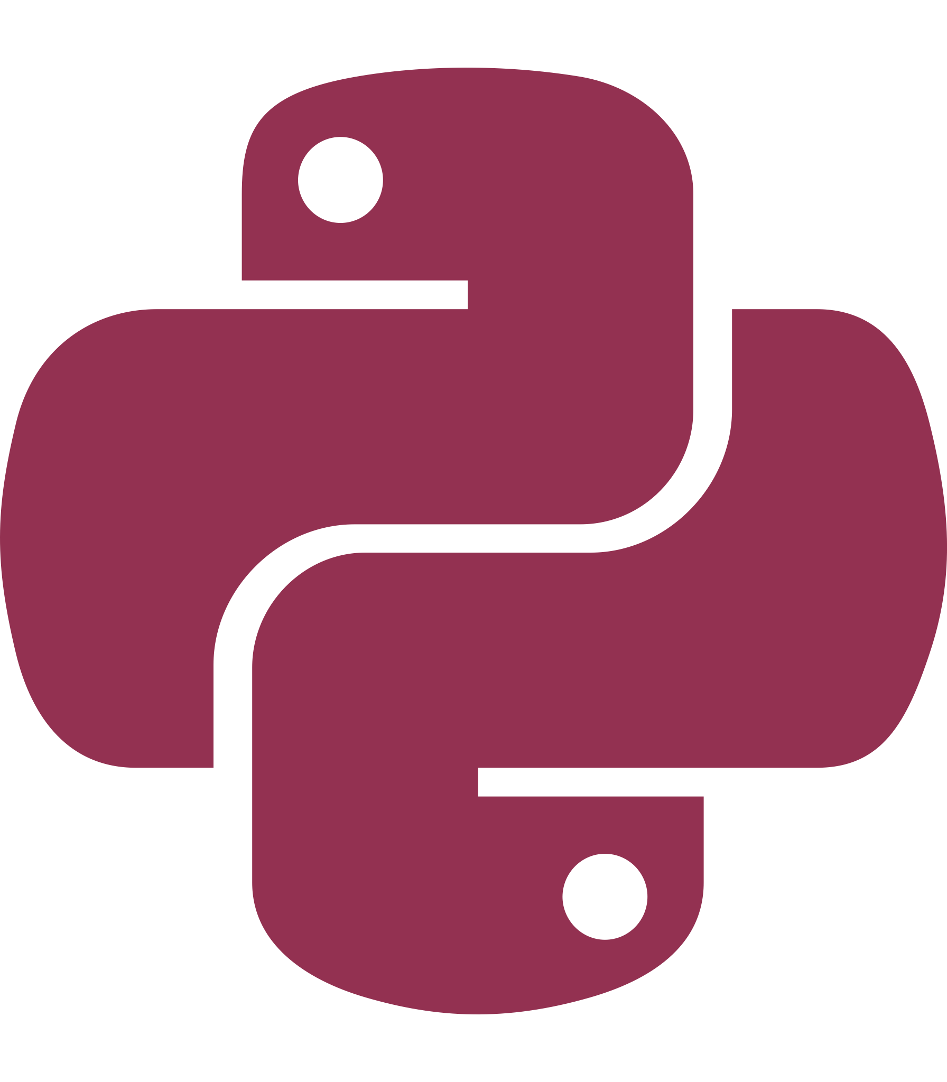
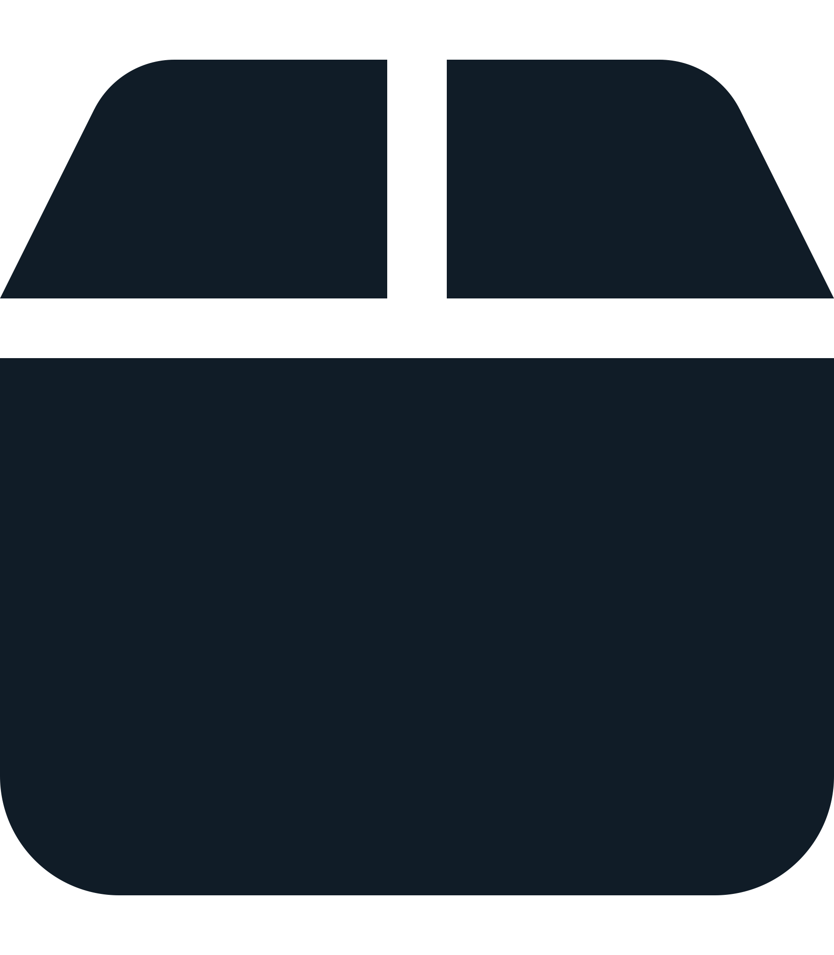
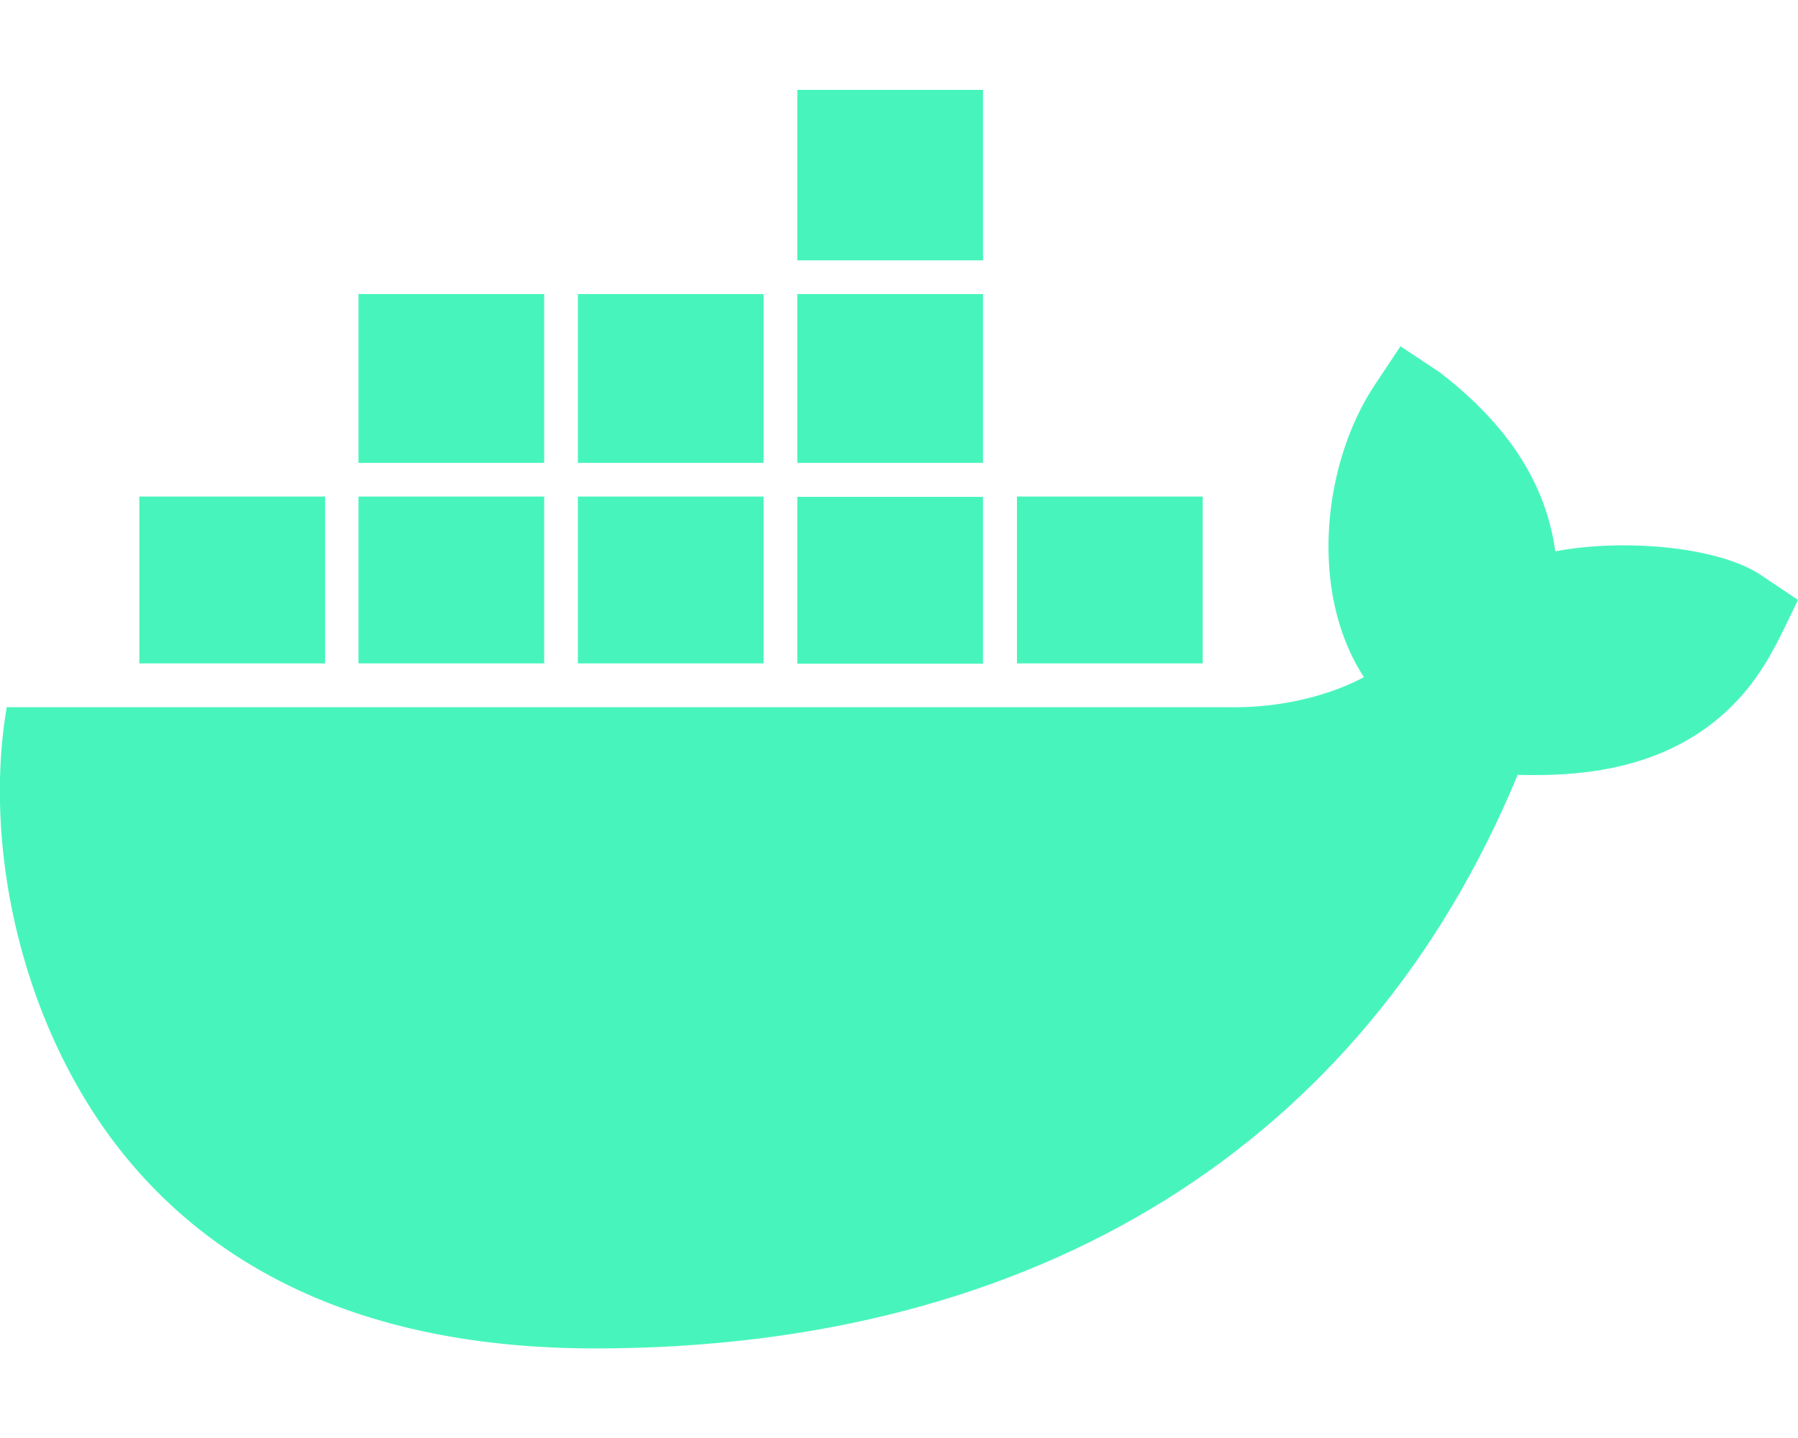
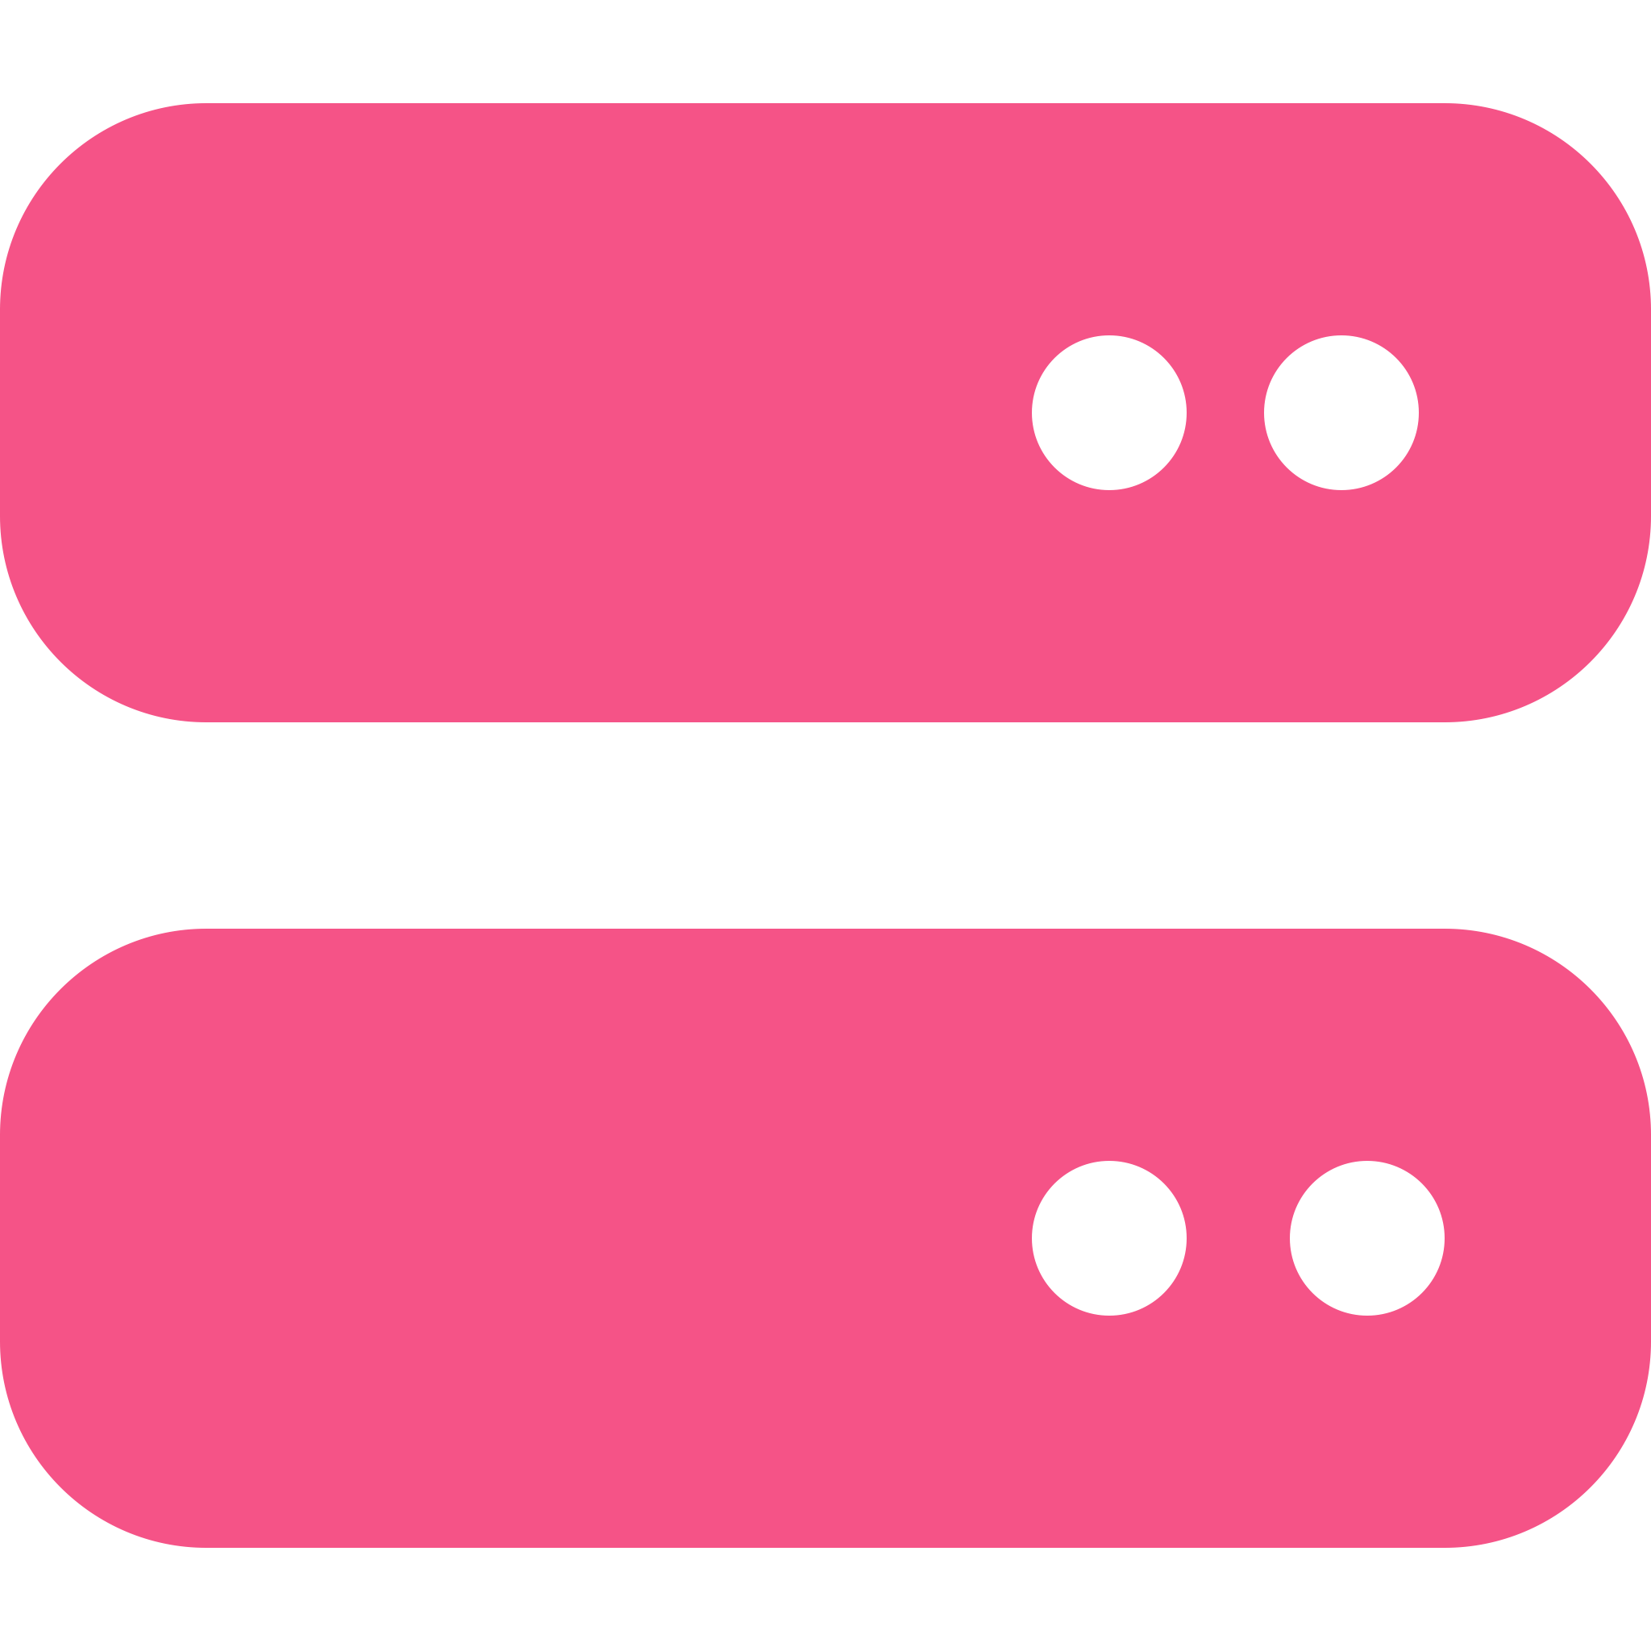
Containers.
Container Image
Dockerfile
Python 3.12
FROM python:3.12.9-alpine3.21
RUN mkdir /opt/my-app
WORKDIR /opt/my-app
COPY ./app.py ./requirements.txt .
RUN \
apk add --no-cache build-base exiv2-dev && \
pip3 install -r requirements.txt && \
apk --no-cache del build-base exiv2-dev && \
apk --no-cache add exiv2
CMD ["python3", "app.py"]
Developers
pycryptodome 3.22.0
Build
Push
pillow 11.1.0
Pull
Flask 3.1.0
Container
Image
Container
Registry
Application Source
Servers
Platforms

Slide 10
Containers.
Isolate user-space resources from kernel
Isolate networking, file-system and process space between different applications running in the same system
Provide a convenient way to create pre-configured environments
Allow simple distribution of stable application environments
Now we have container images. What can we do with them?

Slide 11
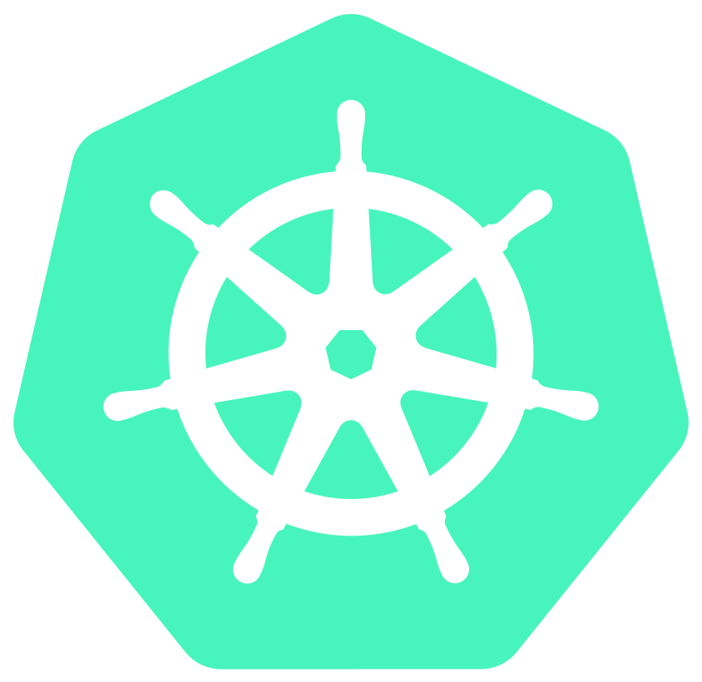

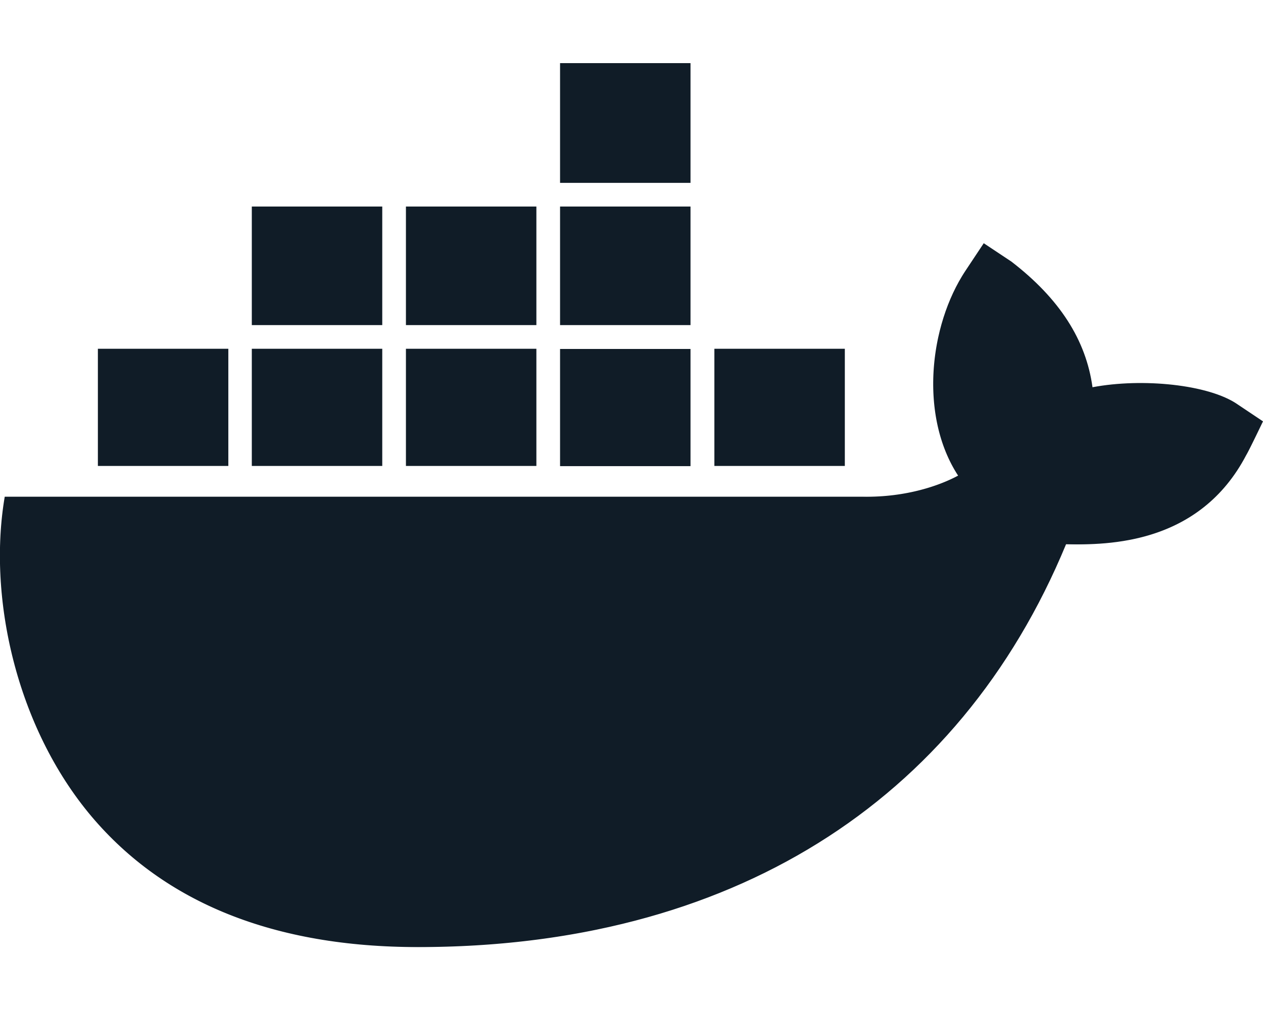
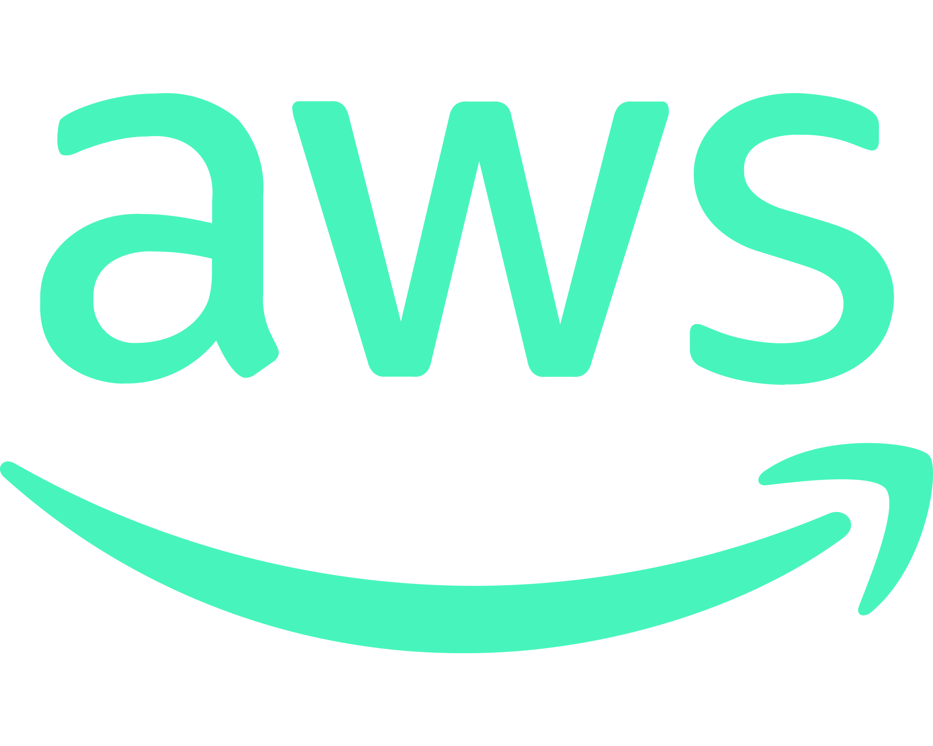


Containers.
my-app:latest
Kubernetes
GCP
Developers
(Anyone)
AWS ECS
AWS EKS
AWS EC2
Container
Registry
Linux
Docker Engine
Docker Compose
containerd
DigitalOcean

Slide 12
Containers.
Container runtimes (Docker, containerd, CRI-) are Linux-based subsystems to run containers
Supported by various on-premise, private and public cloud infrastructures
Kubernetes
Google Cloud Platform, Amazon AWS, DigitalOcean
and much more…
Ease of development and environment sharing. Use Compose.

Slide 13


Docker Compose
docker-compose.yaml
services:
db:
image: bitnami/postgresql:17.4.0
volumes:
- ./data/postgresql:/bitnami/postgresql:rw
redis:
image: redis:7.4.2-alpine3.21
volumes:
- ./data/redis:/data:rw
my-app:
image: ghcr.io/castorw/techtalk-k8s-202503-my-app:latest
restart: always
ports:
- 0.0.0.0:8080:8080
postgresql:17.4.0
redis:7.4.2-alpine3.21
my-app:latest

Slide 14
Docker Compose
Convenient way to easily describe infrastructure
Perfect for quick environment sharing
Suitable for smaller application deployments on VPS/VMs
Can be combined with Docker Swarm to distribute the load to multiple machines
Easy to use infrastructure definitions for quick deployment. Let’s automate!

Slide 15
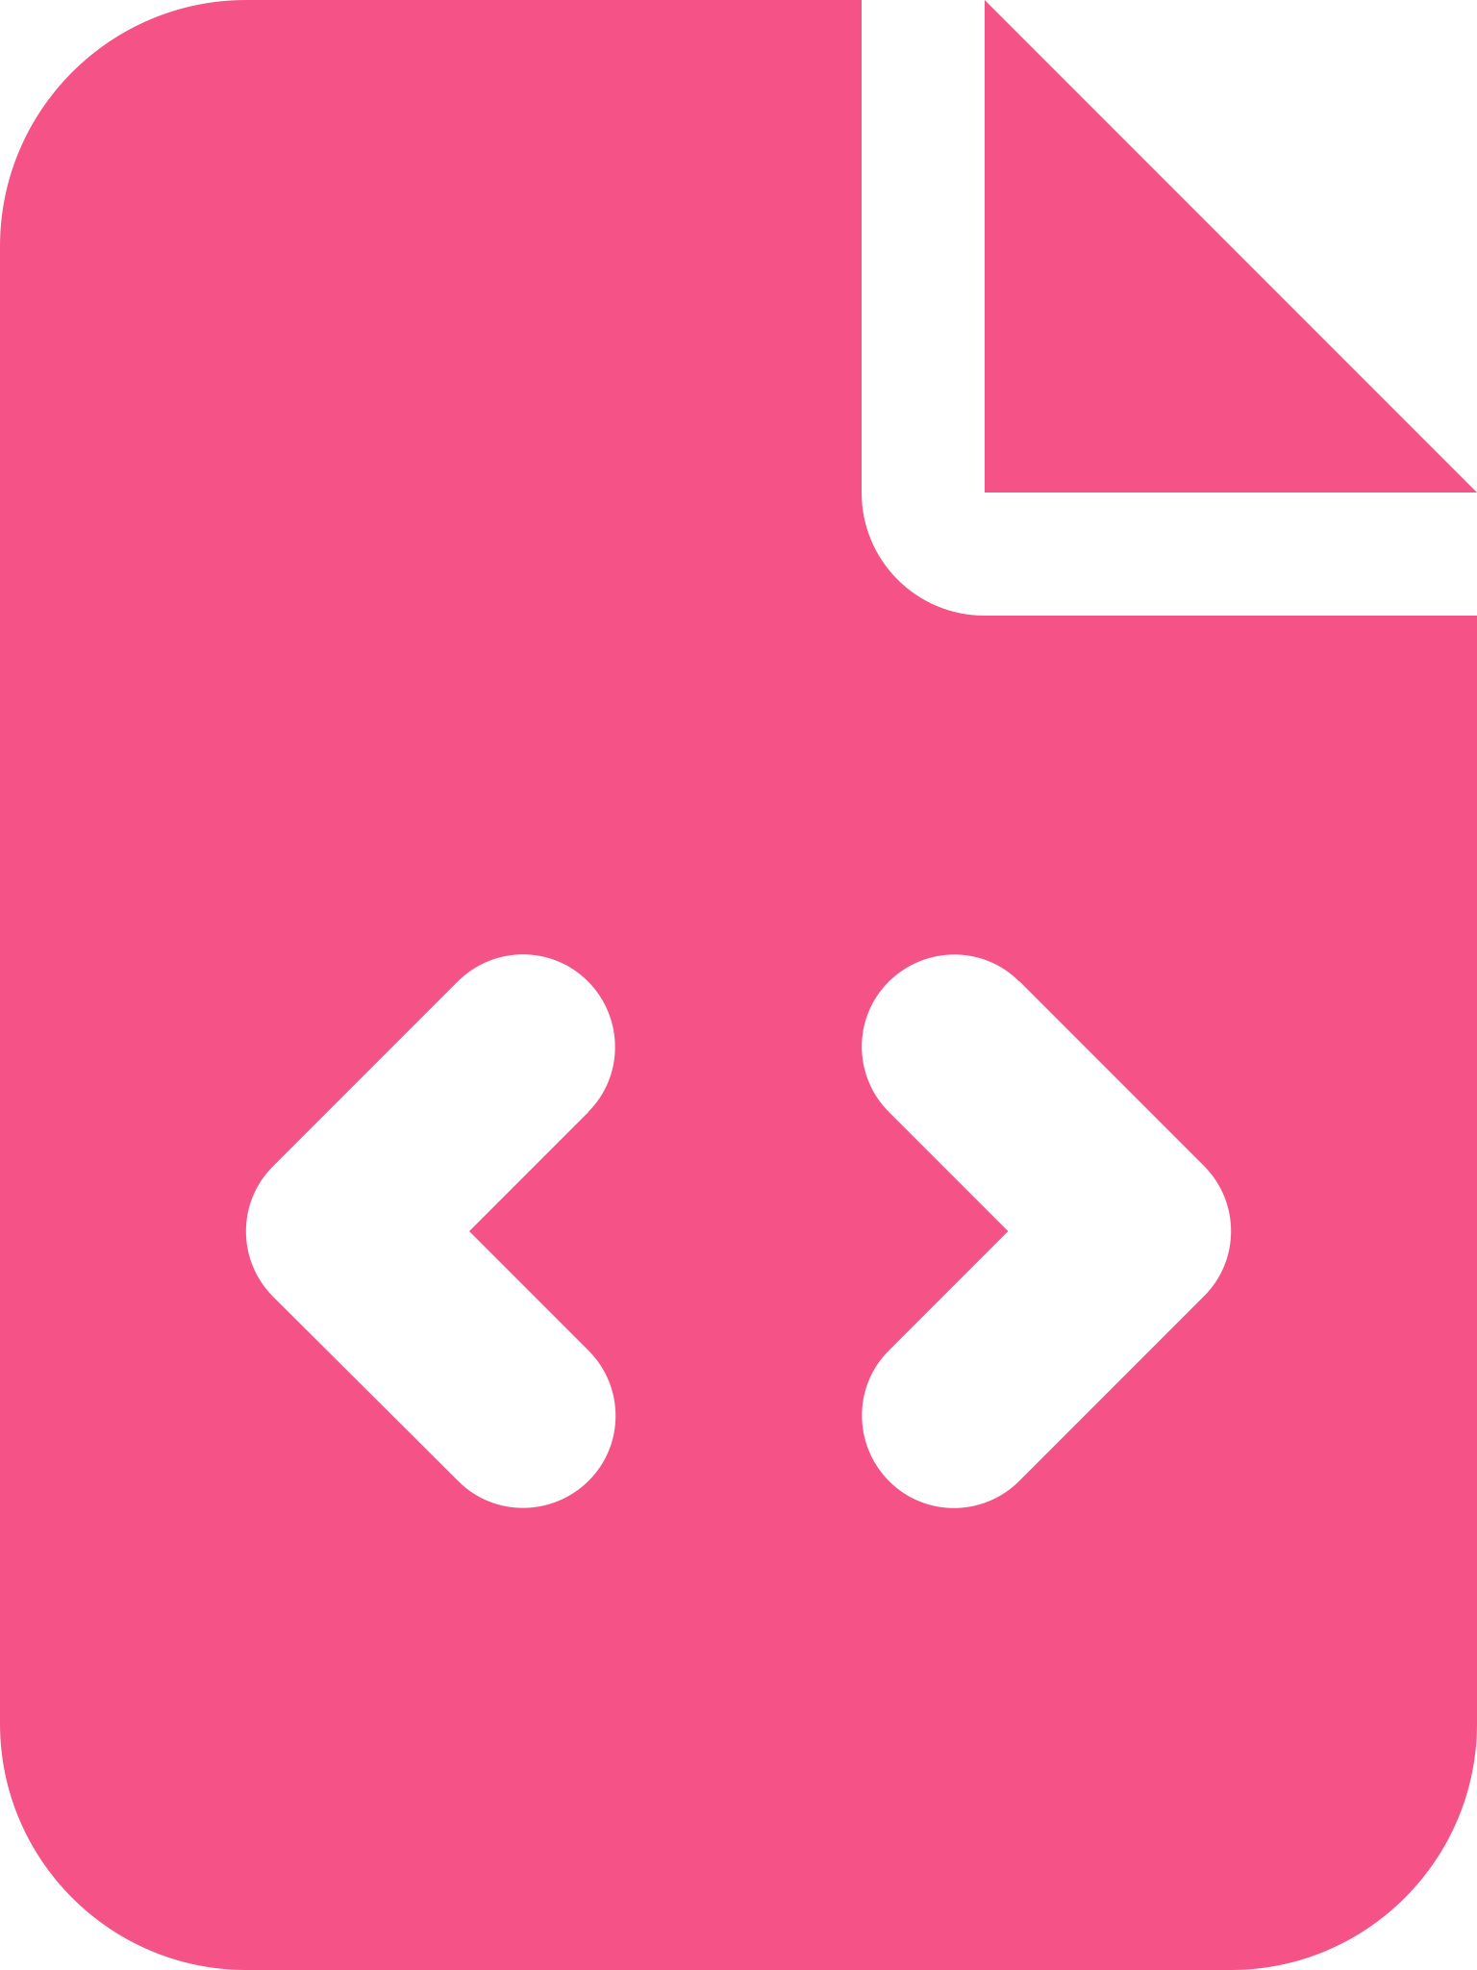

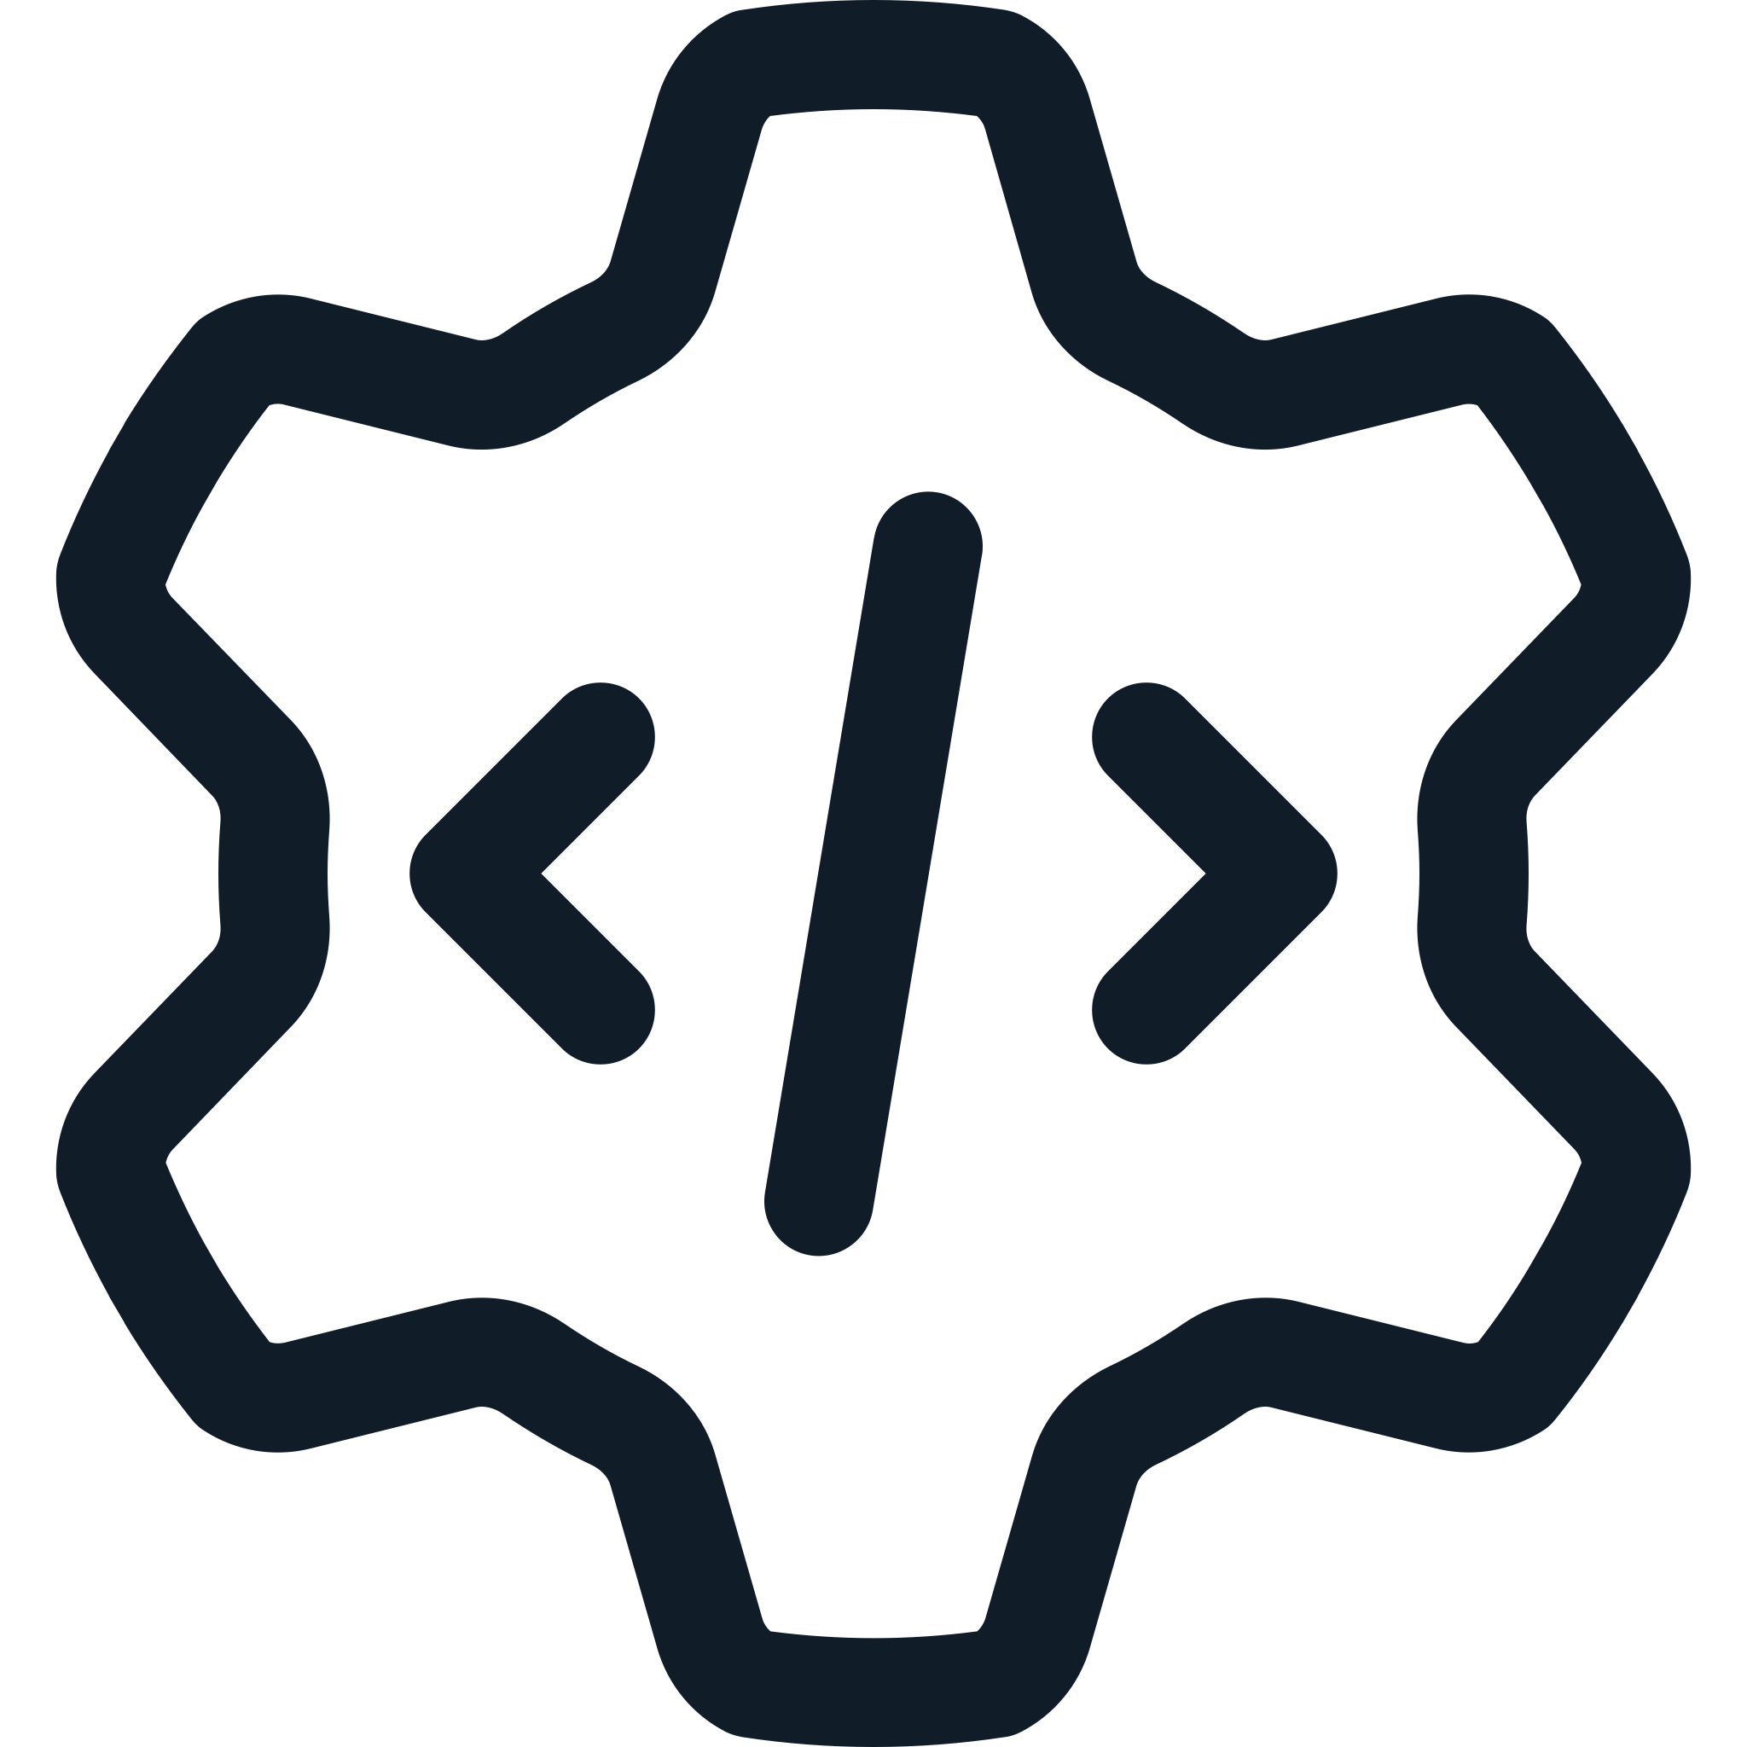

CI/CD Pipelines
CI/CD Pipeline
Lint
Code
Source Control
(GitHub)
CI/CD Tooling
(GitHub Actions)
Build
Test
Publish
Container
Image
Container
Registry

Slide 16
CI/CD Pipelines
Repository-level automation covering various use-cases
Code Linting
Builds / Compilations
Testing / Test Coverage
Packaging
Publishing
Deployment
Provided by most source control providers (GitHub, GitLab, Bitbucket, Azure DevOps, …)
The essentials have been covered. Let’s do this at a scale!

Slide 17
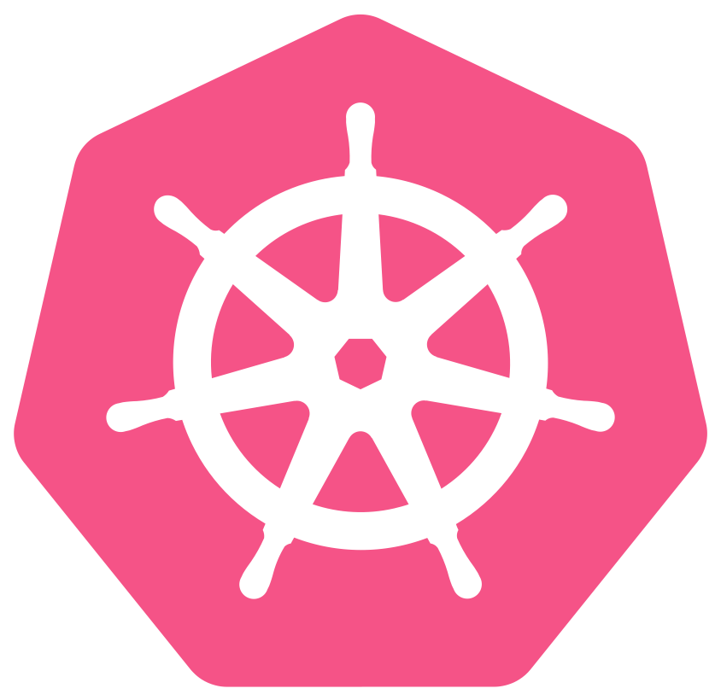
What is Kubernetes?
Control Plane
Control
Node
Control
Node
Control
Node
Workload
Worker
Node
Worker
Node
Worker
Node
Worker
Node
Worker
Node

Slide 18
What is Kubernetes?
Kubernetes is a distributed open-source containerized deployment management and automation system
Kubernetes is a resource manager and controller
Can scale to high numbers of nodes (VMs/servers) and run thousands of containerized applications
Controllers run within the cluster watch and manage Kubernetes resources and reconcile them to desired state
Resource state convergence based on reconciliation

Slide 19
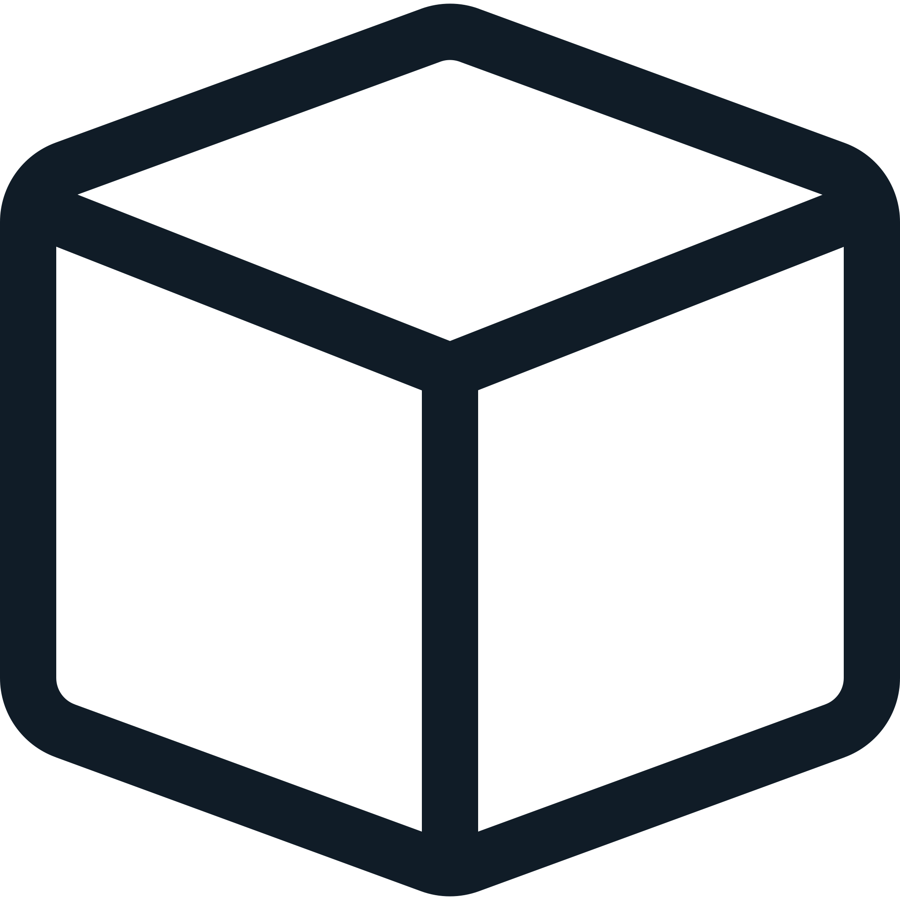
What is Kubernetes?
Control
Node
Worker
Node
etcd
my-app-db
kube-apiserver
my-app-server
kube-cm
kube-scheduler
kube-proxy

Slide 20
What is Kubernetes?
Kubernetes is a highly modular platform
Container Runtime Interface (CRI)
Container Network Interface (CNI)
Container Storage Interface (CSI)
Various Network Topologies
Various Ingress Controllers
Various whatever…
Vanilla Kubernetes (VMs, Bare-metal, …) provides most flexibility but comes at cost of increased complexity (DIY)
Managed Kubernetes (AWS, GCP, DO, …) is the quickest solution to get your apps running as quickly as possible

Slide 21
Kubernetes Resources
ConfigMap
apiVersion: v1
kind: ConfigMap
metadata:
name: argocd-cm
namespace: argocd
labels:
app.kubernetes.io/component: server
app.kubernetes.io/instance: argocd
data:
admin.enabled: "true"
application.instanceLabelKey: argocd.argoproj.io/instance
application.sync.impersonation.enabled: "false"

Slide 22
Kubernetes Resources
Deployment
apiVersion: apps/v1
kind: Deployment
metadata:
name: my-app-server
namespace: my-app-prod
spec:
replicas: 3
template:
spec:
containers:
- name: server
image: ghcr.io/castorw/techtalk-k8s-202503-my-app:latest
ports: ...
env: ...
resources: ...
volumeMounts: ...
livenessProbe: ...
readinessProbe: ...

Slide 23
Kubernetes Resources
Base resources
Node – a VM or server running base Kubernetes components
Namespace – provides isolation of environments/applications
Pod – smallest element of Kubernetes (wraps containers)
Deployment – describes application deployment
StatefulSet – describes stateful application deployment
ConfigMap – stores configuration files
Secret – stores sensitive information (credentials, keys, …)
Service – makes applications accessible within or outside cluster
Ingress – extended resource for HTTP-based endpoints

Slide 24
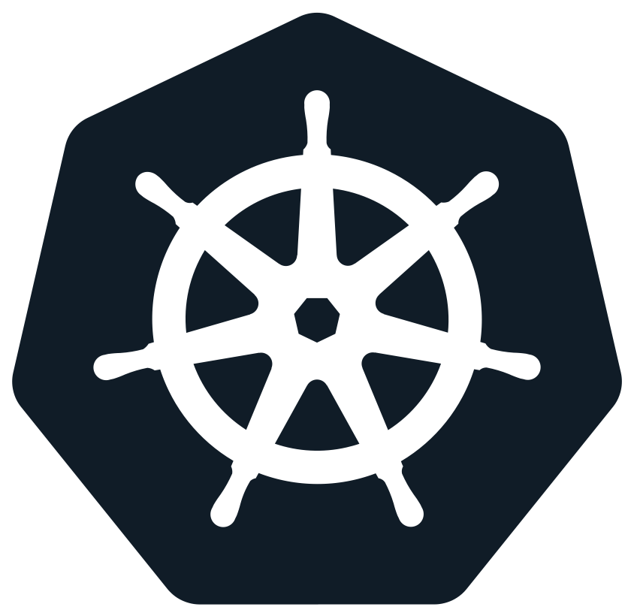

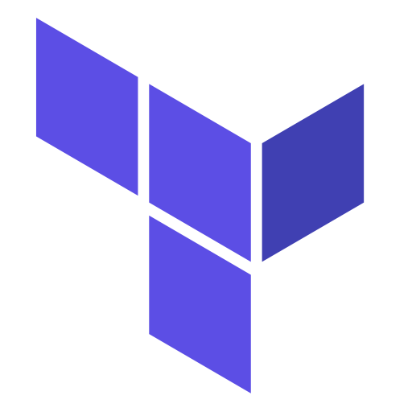
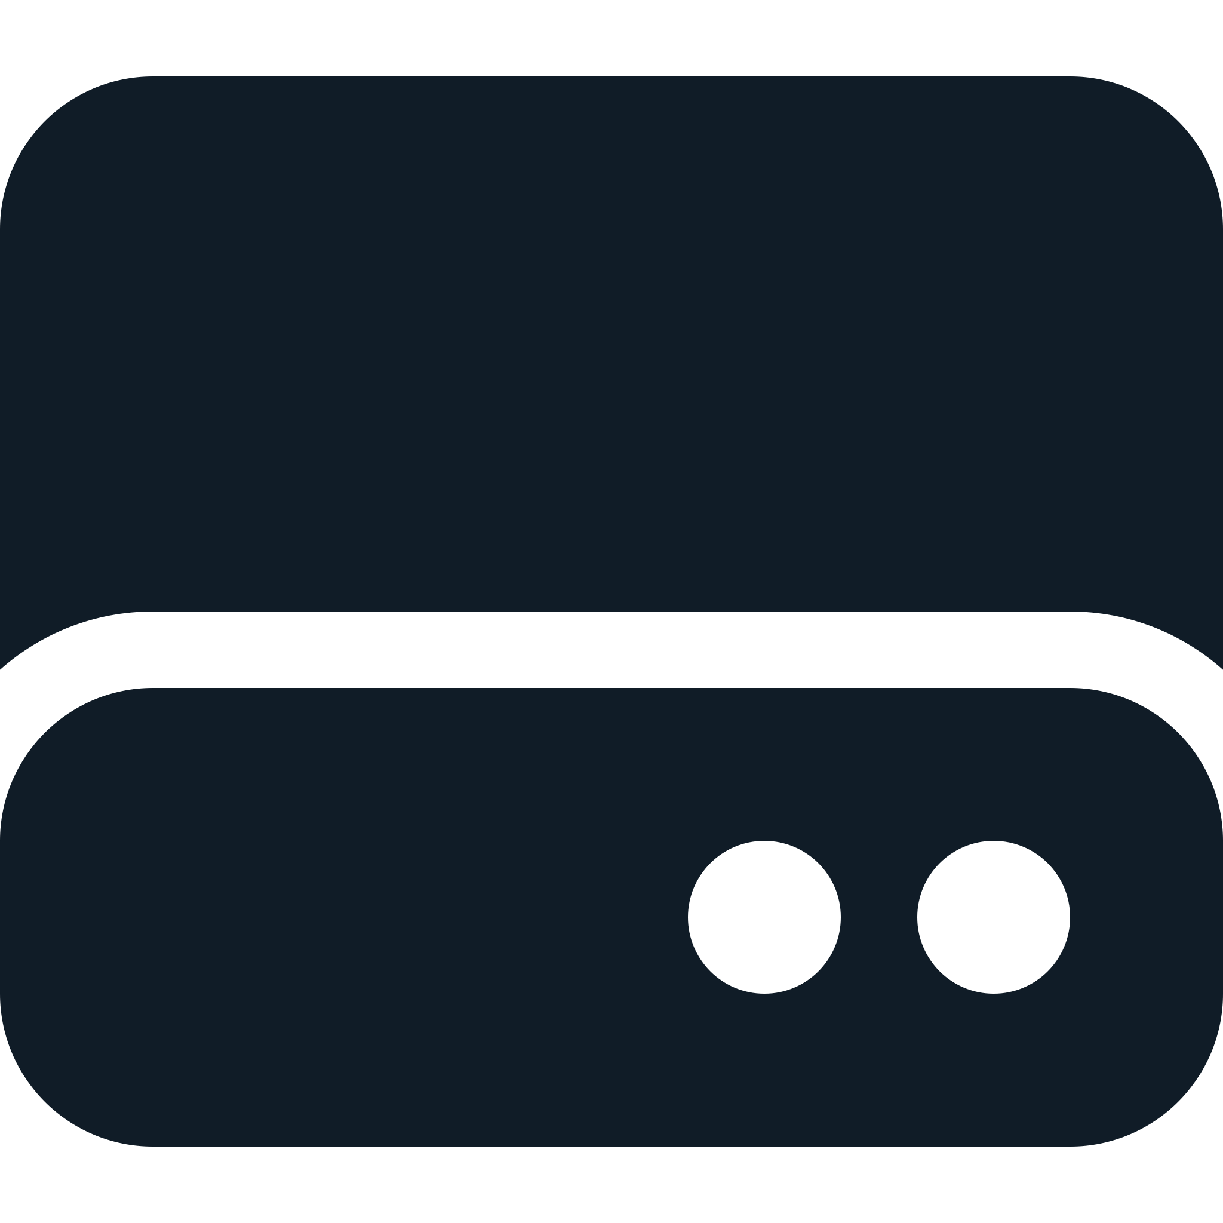
DEMO: The Stack
Helm Releases
DigitalOcean
Metrics Server
Kubernetes Cluster
Ingress NGINX
DNS Domain Service
External DNS
Load-Balancer
Cert-manager
Block Storage
ArgoCD
Terraform
(IaaC)

Slide 25
DEMO: The Stack
DigitalOcean Managed Services – Kubernetes, DNS, Load-Balancing, Block Storage
Kubernetes Infrastructure Applications
Metrics Server
Ingress NGINX
Cert-manager
ArgoCD
Helm – Kubernetes template-based package manager
Infrastructure as a Code approach using Terraform
No manual interactions to deploy entire application

Slide 26
DEMO: Terraform
01-k8s-cluster.tf
resource "digitalocean_kubernetes_cluster" "cluster" {
name = var.k8s_cluster_name
region = "fra1"
version = "1.32.2-do.0"
auto_upgrade = false
destroy_all_associated_resources = true
kubeconfig_expire_seconds = 315360000
node_pool {
name = "${var.k8s_cluster_name}-pool-1"
size = "s-1vcpu-2gb"
node_count = 3
}
}

Slide 27
DEMO: Terraform
Allows definition of cluster resources as a code
Manages dependencies and syncs resource states in required order
Takes care of differences between live resource and desired state in code
Stores full state information

Slide 28
DEMO: Helm
Helm is a ”package manager” based on templates
Generates YAML files containing Kubernetes resources
Uses templating to generate resources from provided values
Provides high reusability of application templates
Template packages are called Helm Charts

Slide 29
DEMO: ArgoCD
ArgoCD is a complete continuous delivery toolchain for Kubernetes
Can use Helm to generate application manifests and apply them to cluster
Monitors state of the application and can automatically recover failures
Provides a good-looking user interface for management and troubleshooting

Slide 30
DEMO: Terraform Apply
Create Kubernetes Cluster in DigitalOcean
Create DNS Domain in DigitalOcean
Install Metrics Server using Helm Provider
Install External DNS Controller using Helm Provider
Install Cert-manager using Helm Provider
Install ArgoCD using Helm Provider
Deploy our app using ArgoCD Application (from Helm Chart)
…in under 10 minutes!

Slide 31
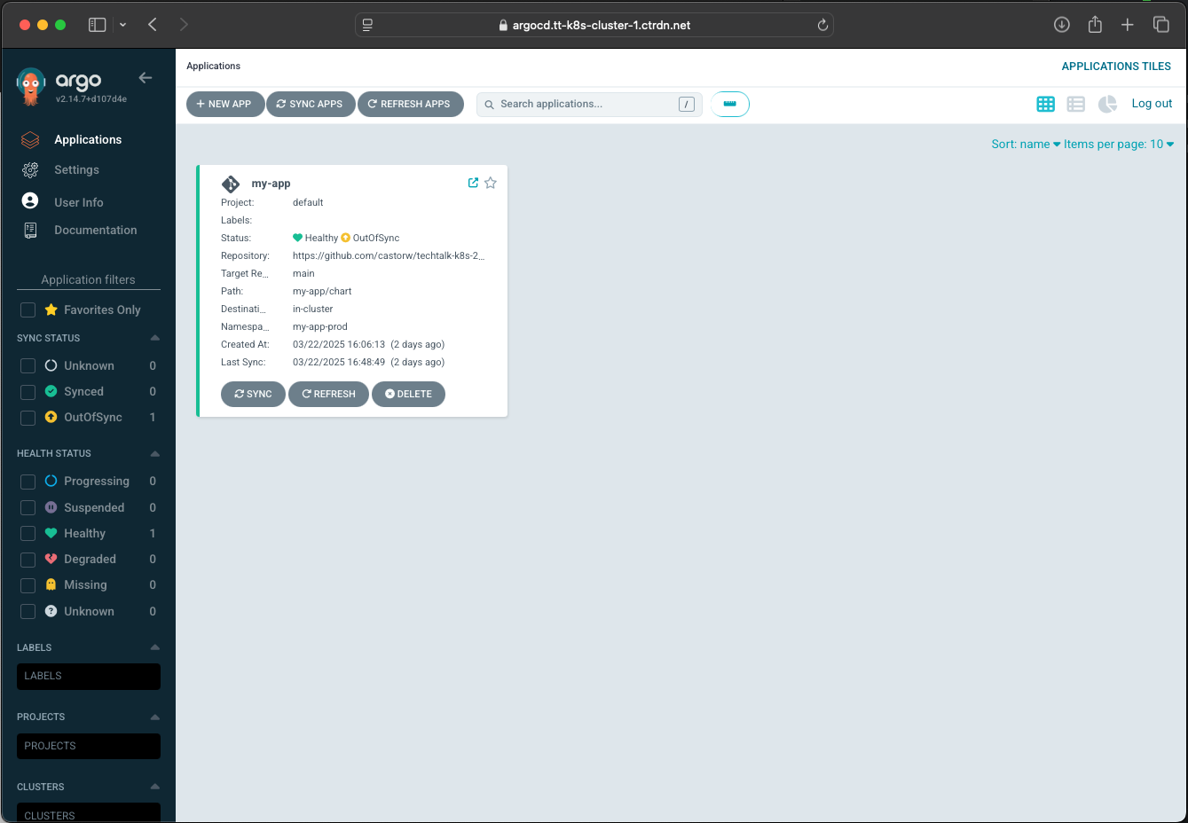
DEMO: ArgoCD

Slide 32
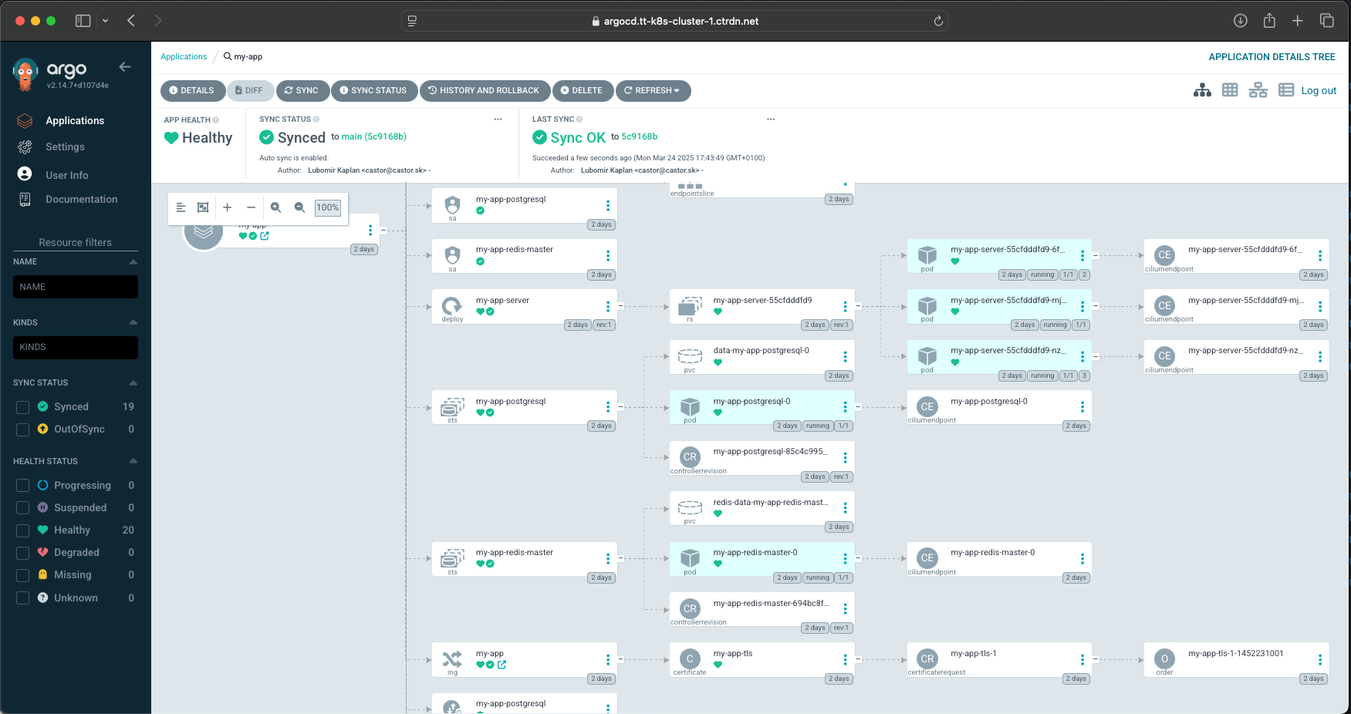
DEMO: ArgoCD

Slide 33
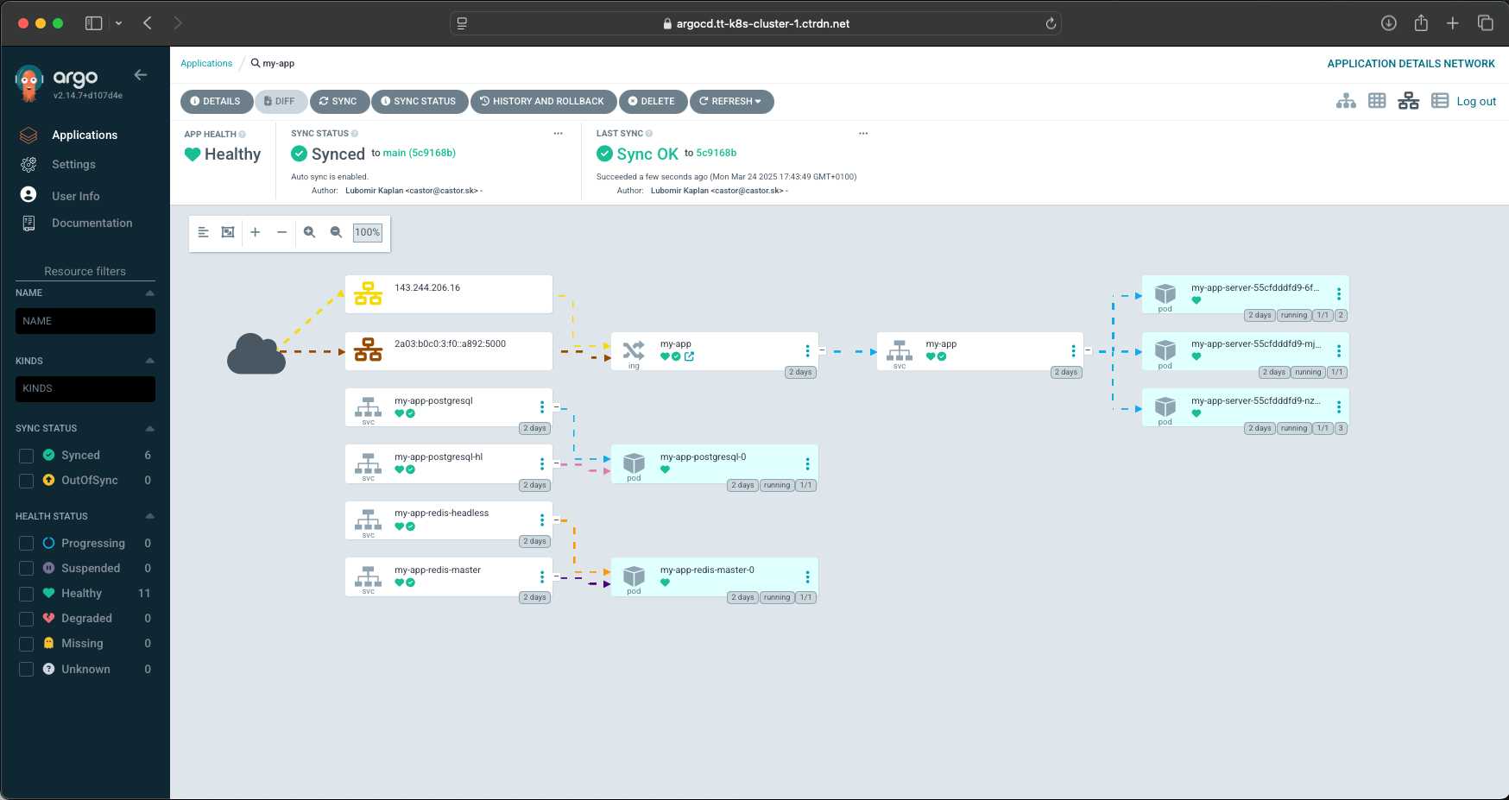
DEMO: ArgoCD

Slide 34


Demo: Repository
https://github.com/castorw/techtalk-k8s-202503
https://bit.ly/ttk8s202503

